Slide 1
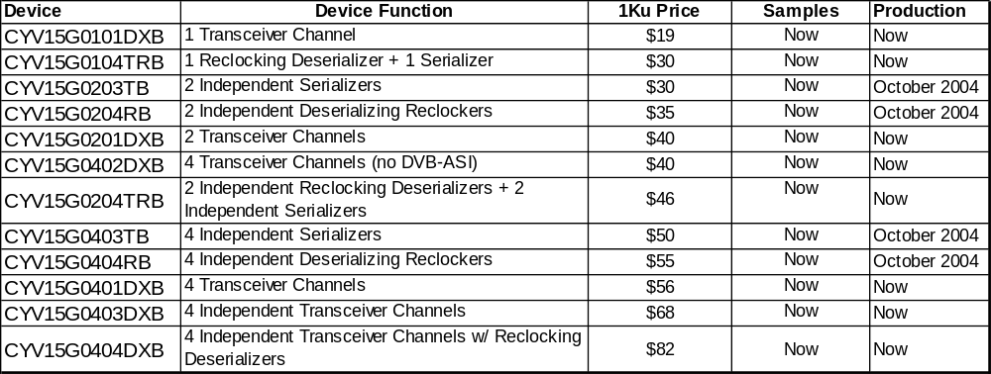
HOTLink-On-Demand Video Portfolio

